Slide 1
Chapter 2 – Software Processes

Slide 2
The software process
Software process: A structured set of activities required to develop a software system.
All software processes should involve:
Specification – defining what the system should do;
Design – designing what the system should do;
implementation – defining the organization of the system and implementing the system;
Validation – checking that it does what the customer wants;
Evolution – changing the system in response to changing customer needs.
A software process model is an abstract representation of a process.
It presents a description of a process from some perspective.

Slide 3
The Process activities involve:
specifying a data model
For example,
Hierarchical Data Model.
Relational Data Model.
Entity-relationship (ER) Data Model.
Object-oriented Data Model.
Dimensional Data Model.
designing a user interface.(layouts’ protoype)
ordering of the activities.

Slide 4
Process descriptions include:
Products,
outcomes of a process activity;
Roles,
responsibilities of the people involved in the process;
Pre- and post-conditions,
which are statements that are true before and after a process activity has been enacted or a product produced.
Example authorization module’s pre and post conditions.

Slide 5
Software processes
Plan-driven processes:
all the process activities are planned
progress is measured against this plan.
agile processes
planning is incremental
Can change plans as per changes in customer requirements.
In practice, most practical processes include elements of both plan-driven and agile approaches.
There are no right or wrong software processes.

Slide 6
Software process models

Slide 7
Software process models
The waterfall model
Plan-driven model.
Separate and distinct phases of specification and development.
Incremental development
Specification, development and validation are interleaved.
May be plan-driven or agile.
Integration and configuration
The system is assembled from existing configurable components.
May be plan-driven or agile.
Practically, most large systems are developed using a process that incorporates elements from all these models.

Slide 8
The waterfall model
In principle, a phase must be complete before moving onto the next phase.

Slide 9
Waterfall model phases
phases in the waterfall model:
Requirements analysis and definition
System and software design
Implementation and unit testing
Integration and system testing
Operation and maintenance
Drawback:
intolerance to change in requirements after the process is underway.

Slide 10
Waterfall model problems
Clearly defined requirements
Limited to large systems.

Slide 11
Waterfall model problems
Inflexible partitioning of the project into distinct stages makes it difficult to respond to changing customer requirements.
Therefore, this model is only appropriate when the requirements are well-defined, and changes will be fairly limited during the design process.
stable requirements are very rare.
The waterfall model is mostly used for large systems engineering projects where a system is developed at several sites.
In those circumstances, the plan-driven nature of the waterfall model makes the coordination among members easy.

Slide 12
Incremental development

Slide 13
Incremental development benefits
Reduced changes’ Cost
Customer feedback ease
Rapid delivery & deployment of useful software
The process is not visible.
System structure tends to degrade as new increments are added.

Slide 14
Incremental development benefits
Reduced changes’ Cost
The cost of accommodating changing customer requirements is reduced.
The amount of analysis and documentation that has to be redone is much less than is required with the waterfall model.
Customer feedback ease
It is easier to get customer feedback on the development work that has been done.
Customers can comment on demonstrations of the software and see how much has been implemented.
Rapid delivery & deployment of the useful software
More rapid delivery and deployment of useful software to the customer is possible.
Customers are able to use and gain value from the software earlier than is possible with a waterfall process.

Slide 15
Incremental development problems
The process is not visible.
Managers need regular deliverables to measure progress.
For deploying system quickly, mostly the documentation is not done to reduce development cost. So, in the end no documentation is present w.r.t each version.
System structure tends to degrade as new increments are added.
Frequent change in requirements tends system to degrade as refactoring is needed after each increment to system.
Incorporating multiple software changes becomes increasingly difficult and costly.

Slide 16
Integration and configuration
Based on software reuse
Systems are integrated from existing components or application systems (sometimes called COTS -Commercial-off-the-shelf systems).
Reused elements may be configured to adapt their behaviour and functionality to a user’s requirements
Reuse is now the standard approach for building many types of business systems.

Slide 17
Types of reusable software
Stand-alone application systems (sometimes called COTS) that are configured for use in a particular environment.
A package to be integrated with some framework like .NET
Web services that are developed according to service standards and which are available for remote invocation.

Slide 18
Reuse-oriented software engineering

Slide 19
Key process stages
Requirements’ specification
Software discovery and evaluation
Requirements’ refinement
Application system configuration
Component adaptation and integration

Slide 20
Advantages and disadvantages
Advantages | Disadvantages
Reduced costs and risks as less software is developed from scratch | But requirements compromises are inevitable so it might be possible that the system may not meet the real needs of client
Faster delivery and deployment of the system | Loss of control over the evolution of reused system elements

Slide 21
Process activities

Slide 22
Process activities
The four basic process activities of specification, development, validation and evolution are organized differently in different development processes.
For example,
waterfall model -> process activities are organized in sequence
incremental development model -> interleaved.

Slide 23
The requirements engineering process

Slide 24
Software specification
Its a process of establishing:
what services are required and
the constraints on the system’s operation and development.
Requirements engineering process
Requirements elicitation and analysis
What do the system stakeholders require or expect from the system?
Requirements specification
Defining the requirements in detail
Requirements validation
Whether the requirement is valid or realistic?

Slide 25
Software design and implementation
It’s a process of converting the system specification into an executable system.
Software design
Design a software structure that confirms the specification;
Implementation
Translate this structure into an executable program;
design and implementation activities are closely related and may be inter-leaved.
Design may vary from system to system.
For example, As in real-time systems, the database might be not needed, instead a timing module is required to minimize delay, .

Slide 26
A general model of the design process

Slide 27
Design Inputs
Inputs given to system.
That could be any platform related information like OS , middleware. And any other application systems if needed.
Data descriptions include the data that is to be entered to the system. What could be the appropriate form and so on.
All the specifications mentioned in requirements elicitation phase are the requirements here i.e. the ultimate functional requirements of software.

Slide 28
Design activities
Architectural design
identify the overall structure of the system,
the principal components (subsystems or modules), their relationships and how they are distributed.
Database design
design the system data structures
how these are to be represented in a database.
Decision related to creation of a new database or reuse of an existing database?

Slide 29
Design activities
Interface design
define the interfaces between system components.
Must encapsulate all the complexities
Should be user friendly
Component selection and design,
you search for reusable components.
If unavailable, then you design the component from scratch.
Includes the list of changes to be done in the off the shelf component
or the proper technical UML diagram (if designing from scratch)

Slide 30
System implementation
The software is implemented either by developing a program or programs or by configuring an application system depending upon the scale of software application.
Design and implementation are interleaved activities for most types of software system.
Programming is an individual activity with no standard process. (e.g., variable definition) ~ depends on programmer feasibility.
Debugging is the activity of finding program faults and correcting these faults.

Slide 31
Software validation
Verification and validation (V & V) is intended to show that a system conforms to its specification and meets the requirements of the system customer.
Involves system testing.
System testing involves executing the system with test cases that are derived from the specification of the real data to be processed by the system.
Alpha testing: testing & reviewing by the development staff
Beta testing: testing & reviewing by the real time user

Slide 32
Stages of testing

Slide 33
Testing stages
Component testing
Component tested by developers working on the system.
Individual components are tested independently;
Components may be functions or objects or coherent groupings of these entities.
Test automation tools like Junit for java, VS Code plugin for JS or python could be used for unit/component testing.
System testing
Testing of the system.
Testing of errors after different module interaction.
In large systems multiple subsystems are integrated first and then integrated as a final system.

Slide 34
Testing stages
Customer testing
Beta testing
Testing with customer data to check that the system meets the customer’s needs.
It might reveal error in software requirements, omission if any.

Slide 35
Testing phases in a plan-driven software process (V-model) improvement of waterfall model

Slide 36
Software evolution
Hardware changes are very expensive, as compare to that software is inherently flexible and can be modified to larger & complex systems.
As requirements change through changing business circumstances, the software that supports the business must also evolve and change.
Although there has been a demarcation between development and evolution (maintenance) this is increasingly irrelevant as fewer and fewer systems are completely new.

Slide 37
System evolution

Slide 38
Coping with change

Slide 39
Coping with change
Change is inevitable in all large software projects.
Business changes lead to new and changed system requirements
New technologies open up new possibilities for improving implementations
Changing platforms require application changes
Change leads to rework so :
costs of change = cost of rework (analyzing previous req.) + cost of implementing new module

Slide 40
Reducing the costs of rework
Proactive approach:
Change anticipation: where the software process includes activities that can anticipate possible changes before significant rework is required.
Reactive approach:
Change tolerance, where the process is designed so that changes can be accommodated at relatively low cost.

Slide 41
Coping with changing requirements
What to do when the user is not exactly sure of the requirements?

Slide 42
Coping with changing requirements
System prototyping,
where a version of the system or part of the system is developed quickly to check the customer’s requirements and the feasibility of design decisions.
This approach supports change anticipation.
Incremental delivery,
where system increments are delivered to the customer for comment and experimentation.
This supports both change avoidance and change tolerance.

Slide 43
Software prototyping
A prototype is:
an initial version of a system
used to demonstrate concepts and
Show design options.
Find out about any possible requirements’ problems
Predict their solutions
A prototype can be used in anticipating changes in the process:
Used to refine the requirements elicitation and validation phase;
In design processes to explore options and develop a UI design;
In the testing process to run back-to-back tests.

Slide 44
Benefits of prototyping
Improved system usability. ~ predicts how well the system supports a no. of users.
A closer match to users’ real needs. ~ observe software strengths & weaknesses and then tune its requirements.
Improved design quality.
Reduced development effort. ~ as lesser maintenance required.
Improved maintainability. ~ lesser maintenance needed because of minimal chances in requirements’ falsification.

Slide 45
The process of prototype development

Slide 46
Prototype development
Obviously, the prototype for the whole project is not needed.
Correct way is to develop prototype of the functionalities whose requirements are not clearly mentioned.
Benefits:
This will reduce prototyping cost
Accelerate development schedule
decide what to target:
Prototype should focus on areas of the product that are not well-understood
Focus on functional requirements like core module implementation.
Error checking and recovery may not be included in the prototype;
Nonfunctional requirements like response time and memory utilization are ignored.

Slide 47
Prototype Development
Is it good to proceed further with a prototype?

Slide 48
Throw-away prototypes
Prototypes should be discarded after development as they are not a good basis for a production system
It may be impossible to tune the system to meet non-functional requirements;
Prototypes are normally undocumented;
The prototype structure is usually degraded through rapid change; so, it is not good to proceed further with the prototype.
The prototype probably will not meet normal organizational quality standards.(as it may have lesser response time, no error handling and all)

Slide 49
Incremental delivery
Rather than deliver the system as a single delivery, the software development and delivery is broken down into increments, with each increment delivering part of the required functionality.
User requirements are prioritized by user himself
and the highest priority requirements are included in early increments.
When an increment is under development then its requirements are frozen.
though requirements for later increments can continue to evolve.

Slide 50
Incremental development and delivery
Incremental development
Develop the system in increments
and evaluate each increment before proceeding to the development of the next increment;
Normal approach used in agile methods;
Evaluation is done by user/customer.
Incremental delivery
Deploy an increment for use by end-users;
More realistic evaluation about practical use of software;

Slide 51
Incremental delivery

Slide 52
Incremental delivery advantages
Early increments act as a prototype to help elicit requirements for later increments.
Lower risk of overall project failure.
The highest priority system services tend to receive the most testing. As the first increment is a highly prioritized system that will be tested with every later increment.

Slide 53
Incremental delivery problems
dependence between increments
Difficult to detect as requirements are still evolving
Developing the contract for application is not possible
Might lead to budgetary issues
Specification developed in conjunction with the software

Slide 54
Software Process improvement

Slide 55
Process improvement
For a newly developed Software house, With so many software rivalries in industry…. How to compete and make your place
3 main challenges for software houses:
cheaper software,
better software,
delivered with much tighter deadlines
Solution:
Deliver quality product,
With reduced costs
And to accelerate their development processes to meet deadlines.

Slide 56
Process improvement
Software Process improvement means:
understanding existing processes
and changing these processes to increase product quality
and/or reduce costs and development time.

Slide 57
Approaches to improvement
The process maturity approach:
Focus on improving process and project management
and introduces good software engineering practice into organizations.
Defined process maturity levels to measure the reputation of an organization.
Higher the level of process maturity = good technical and management practice adopted for software development processes.
Goals:
Improve product quality & process predictability
Generally, for plan driven approaches

Slide 58
Approaches to improvement
The agile approach:
focuses on:
iterative development
and the reduction of overheads in the software process.
Characteristics:
rapid delivery of functionality
responsiveness to changing customer requirements.
Agile follows code development with minimal documentations overhead

Slide 59
The process improvement cycle
Measure process -> check if improvement would be feasible -> do the change -> measure the impact of changes on process

Slide 60
Process improvement activities
Process measurement (identify what to change)
measure one/more attributes of the software process or product->
Check if process improvement have been effective -> do improvement -> remeasure the impact after improvement
Process analysis (assess weakness & strengths)
The current process is assessed, and process weaknesses and bottlenecks are identified.
Process models (sometimes called process maps) that describe the process may be developed.
Process change(change the process)
Process changes are proposed to address some of the identified process weaknesses.
These are introduced and the cycle resumes to collect data about the effectiveness of the changes.

Slide 61
Process measurement
Wherever possible, quantitative process data should be collected
However, where organisations do not have clearly defined process standards this is very difficult as you don’t know what to measure. A process may have to be defined before any measurement is possible.
Process measurements should be used to assess process improvements
But this does not mean that measurements should drive the improvements. The improvement driver should be the organizational objectives.

Slide 62
Process metrics
Time taken for process activities to be completed
E.g. Calendar time or effort to complete an activity or process.
Resources required for processes or activities
E.g. Total effort in person-days.
Number of occurrences of a particular event
E.g. Number of defects discovered.

Slide 63
The SEI Capability maturity levels
Rates the maturity of an organization over 5-point scale
Not a software process model.
Provides a mean of measuring how well an organization manages to accomplish the tasks.

Slide 64
CMM initial stage
Initial
Generally, the starting point of any software organization
Unmanaged work
No proper software documentation
No effective project management plans (generally, opt build and fix models)
No cost estimation
Vast majority of the organizations are at this level
Challenges:
Project management, planning and SQA

Slide 65
CMM Managed stage
Managed
Goals associated with project are satisfied
Defined organizational policies (when which process to be used?)
Documented project plan with goals
Resource management is properly done. (technology relevant task force)
Generally working on same types of software

Slide 66
The SEI capability maturity model
Defined
Process management procedures and strategies defined and used
Proper teamwork , teams created and hierarchy maintained
Collaborative learning environment
Quantitatively Managed
Assess organizational performance.
Better project management structures.
Risk analysis and proactive approaches (what if a project fails?)
Optimising
Process improvement strategies defined and used.
Increased adaption to newer trends

Slide 67
Case study 1
Norton LifeLock Inc is a standalone company dedicated to consumer cyber safety. They are the pioneers of some of the security solutions in different domains like endpoint security, information security. They also have a proper team structure for managing their workflow in projects. For clear understanding of the projects, they use prototyping approaches and define the sub activities of each process as well. Moreover, for better product development, they use different techniques to appropriately predict system performance.
CMM level is 5 (optimized) as the organization is developing innovative solutions. Moreover, they have a proper team managed working environment.

Slide 68
Case study 2
Everyday wear is a clothing brand that wants to enter the international market. They have done with logistics and other stuff and only thing that they need is an e-commerce application. They approached an organization named as coding hub to develop an application that could run on cell phones as well as desktops. They have some incomplete set of requirements that could be provided to coding Hub employees . Since Eid holidays are around the corner and they want to deploy some essential components by November.
Level 3 – defined : as they are working on diverse applications (desktop & mobile app)

Slide 69
Case study 3
ABC Co. is an organization that designs Smart Gadgets to make life easier. They have an organized working Environment having proper teams for different kinds of projects that provide smart home solutions. For getting the customer trust, they try to accommodate the possible changes in the system as much as possible. They have also calculated the associated risk for a module and its occurrence in the system. At what level of Capability Maturity Model is ABC Co. operating. Give valid reasons for your answer.
based on the information provided, it is likely that ABC Co. is operating at Level 4: quantitatively managed of the CMM, given their structured working environment and their ability to perform risk assessment for the project.

Slide 70
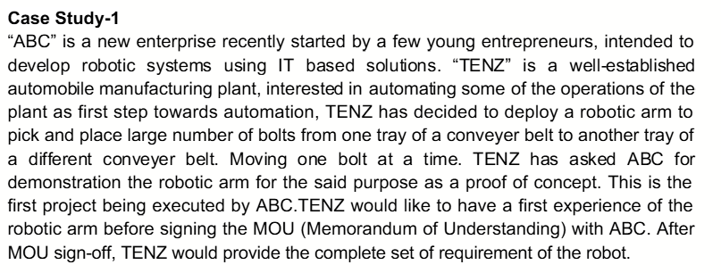
Case study 4 (identify process model)
Answer: Prototyping model

Slide 71
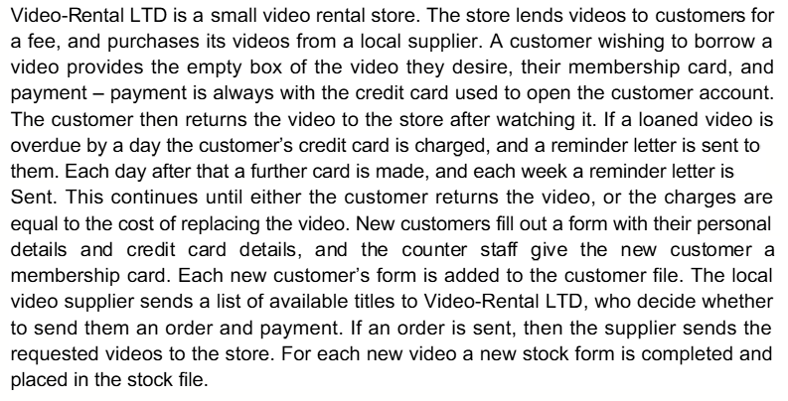
Case study 5 (identify process model)

Slide 72
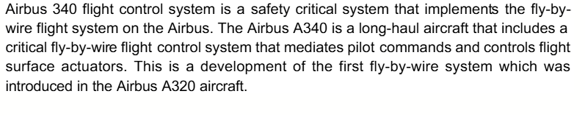
Case study 5 (identify process model)

